Slide 1
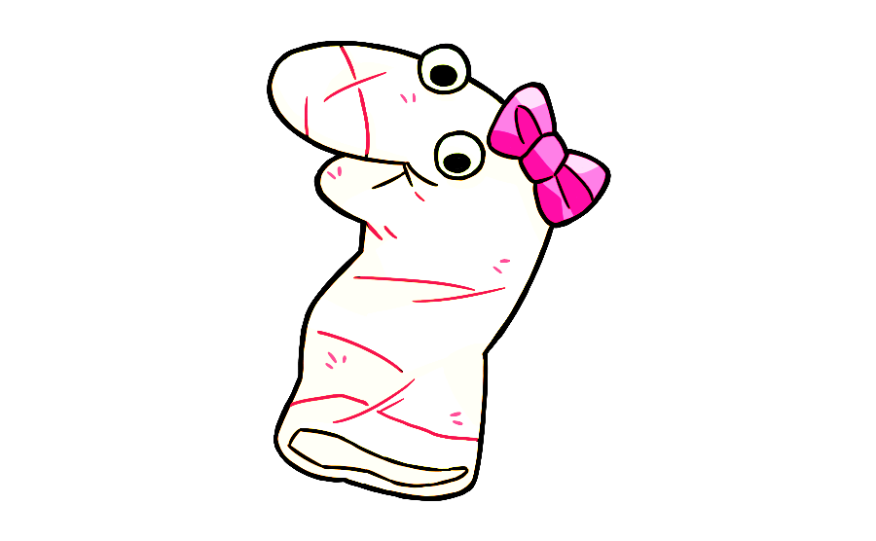
This is my friend Maggie. Say hi to Maggie. She is learning to speak puppet language and needs your help. Would you like to help Maggie learn to speak puppet language?
OK great! Are you ready to help her learn puppet language?

Slide 2
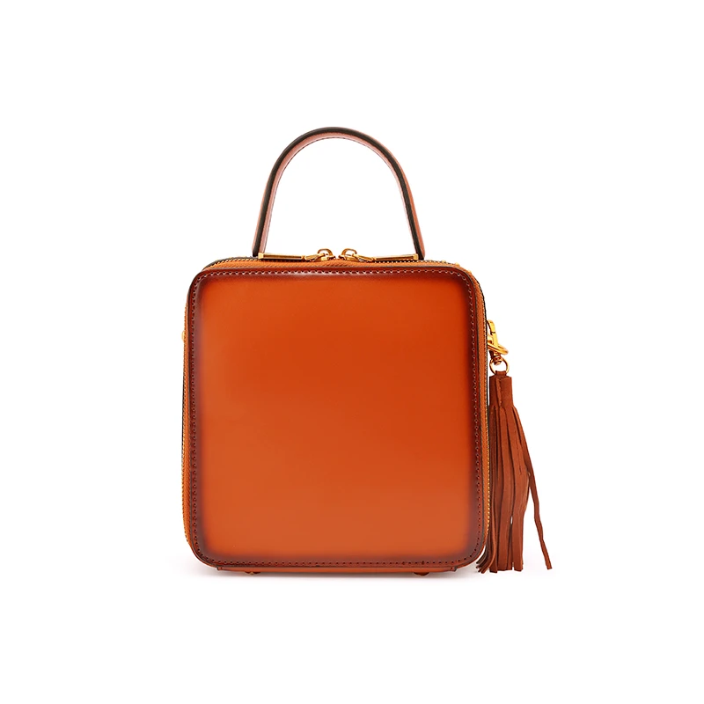
See this? This is a zulu. Zulus are found in stores.
Notes:
Click when saying see this—it will wiggle

Slide 3

See this? It costs a lot of money.
Notes:
Click when saying see this—it will wiggle

Slide 4
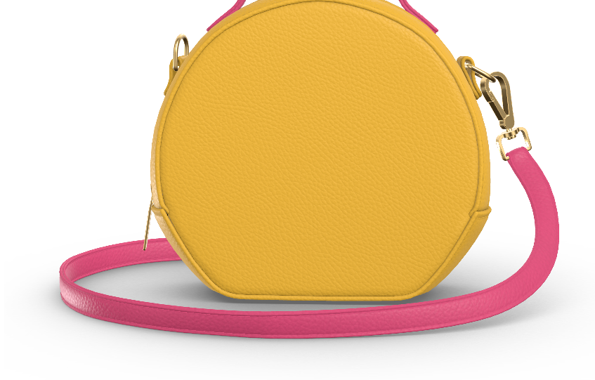
See this? It is found in stores.
Notes:
Click when saying see this—it will wiggle

Slide 5
Notes:
Question: See this zulu (click)? Can you find another zulu? Is it this one on top (click) or this one on bottom (click)?

Slide 6


Thanks for helping Maggie! Let’s help her learn some more puppet language.

Slide 7
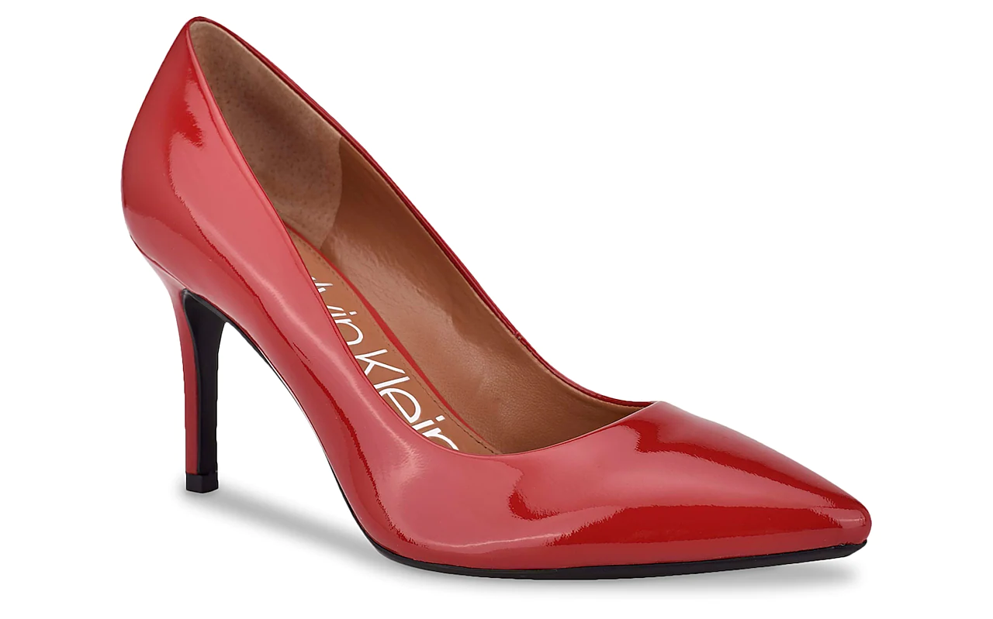
See this? This is a mupa. Mupa is owned by many people.
Notes:
Click when saying see this—it will wiggle

Slide 8
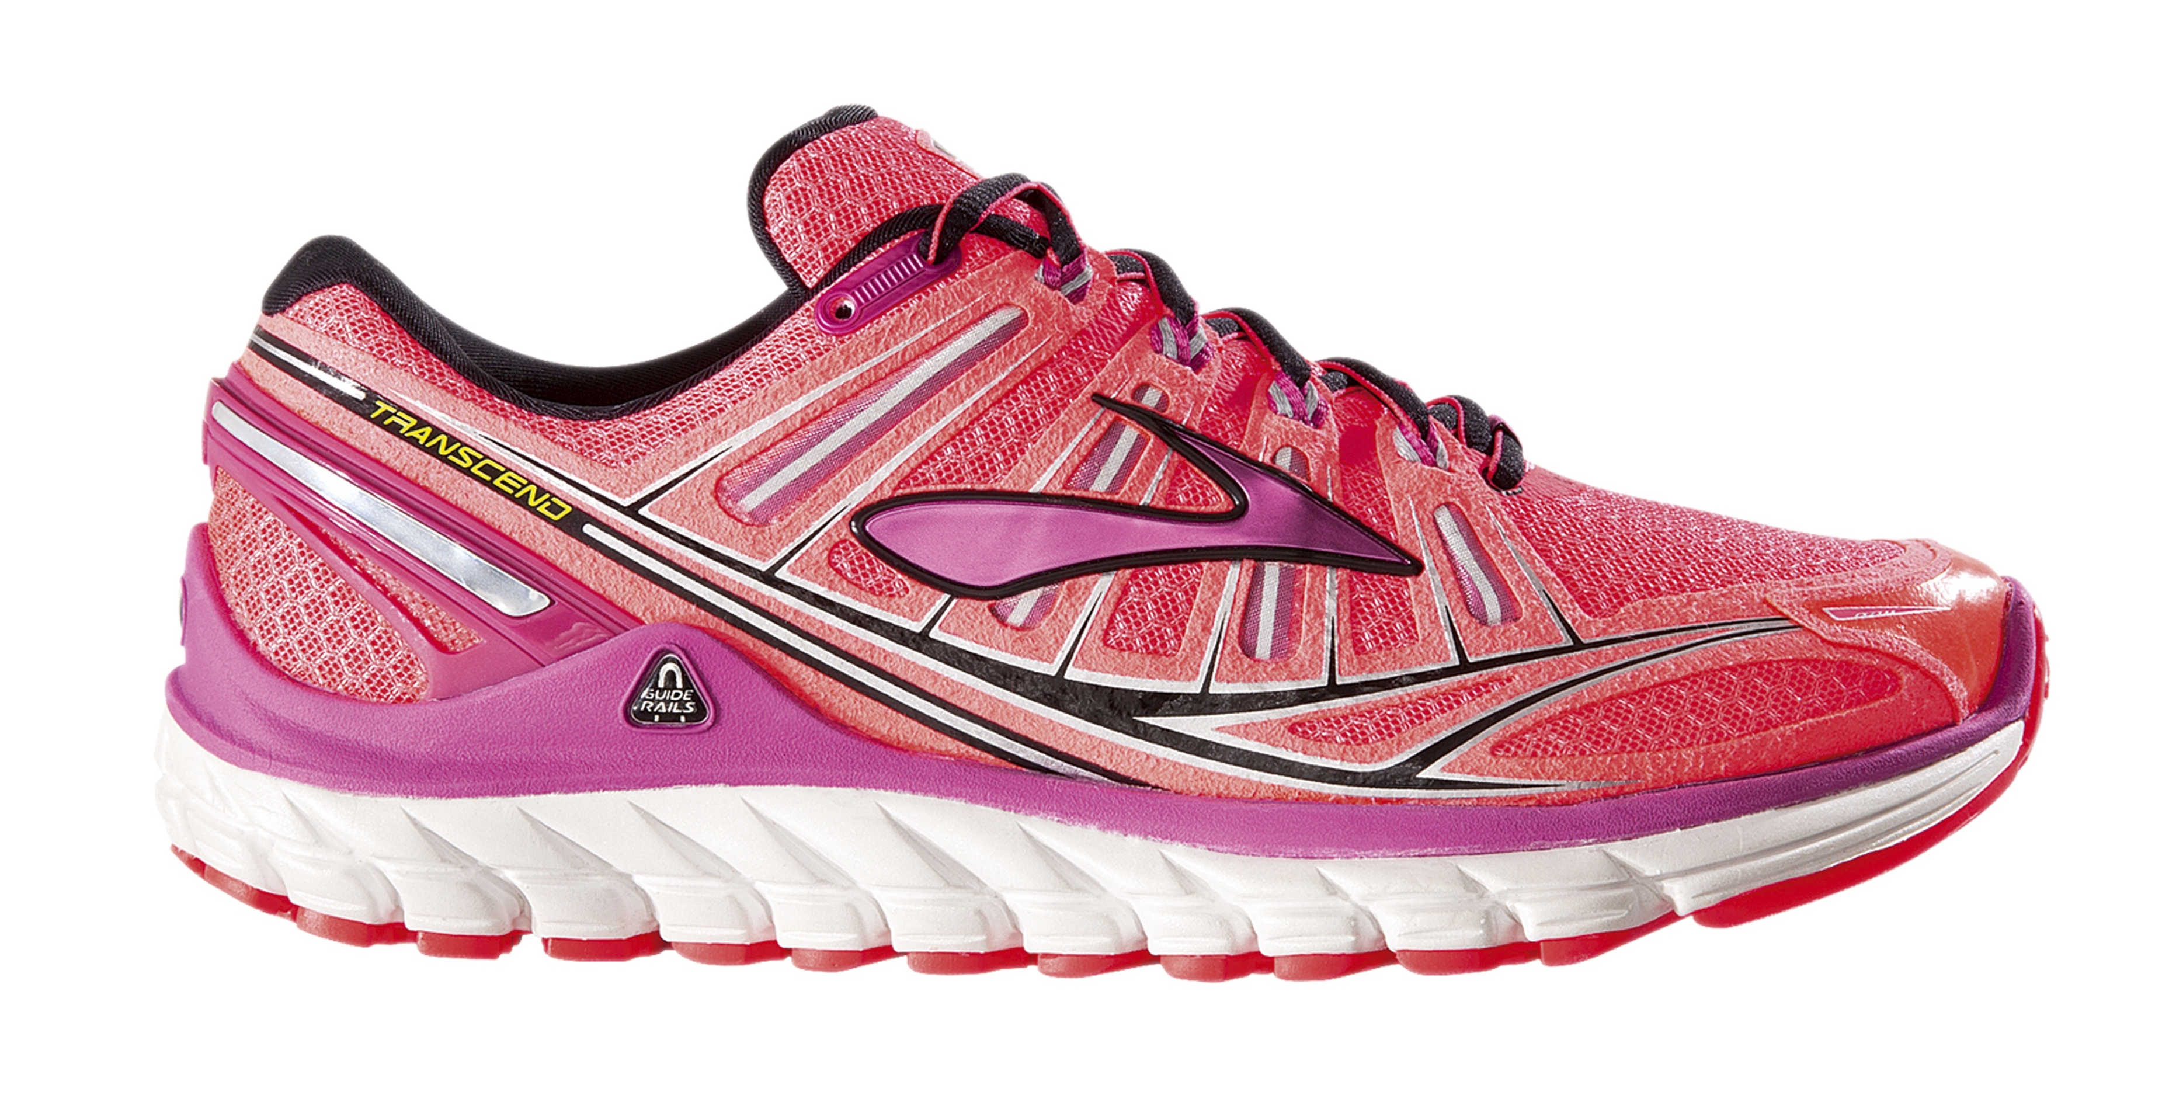
See this? It is owned by many people.
Notes:
Click when saying see this—it will wiggle

Slide 9
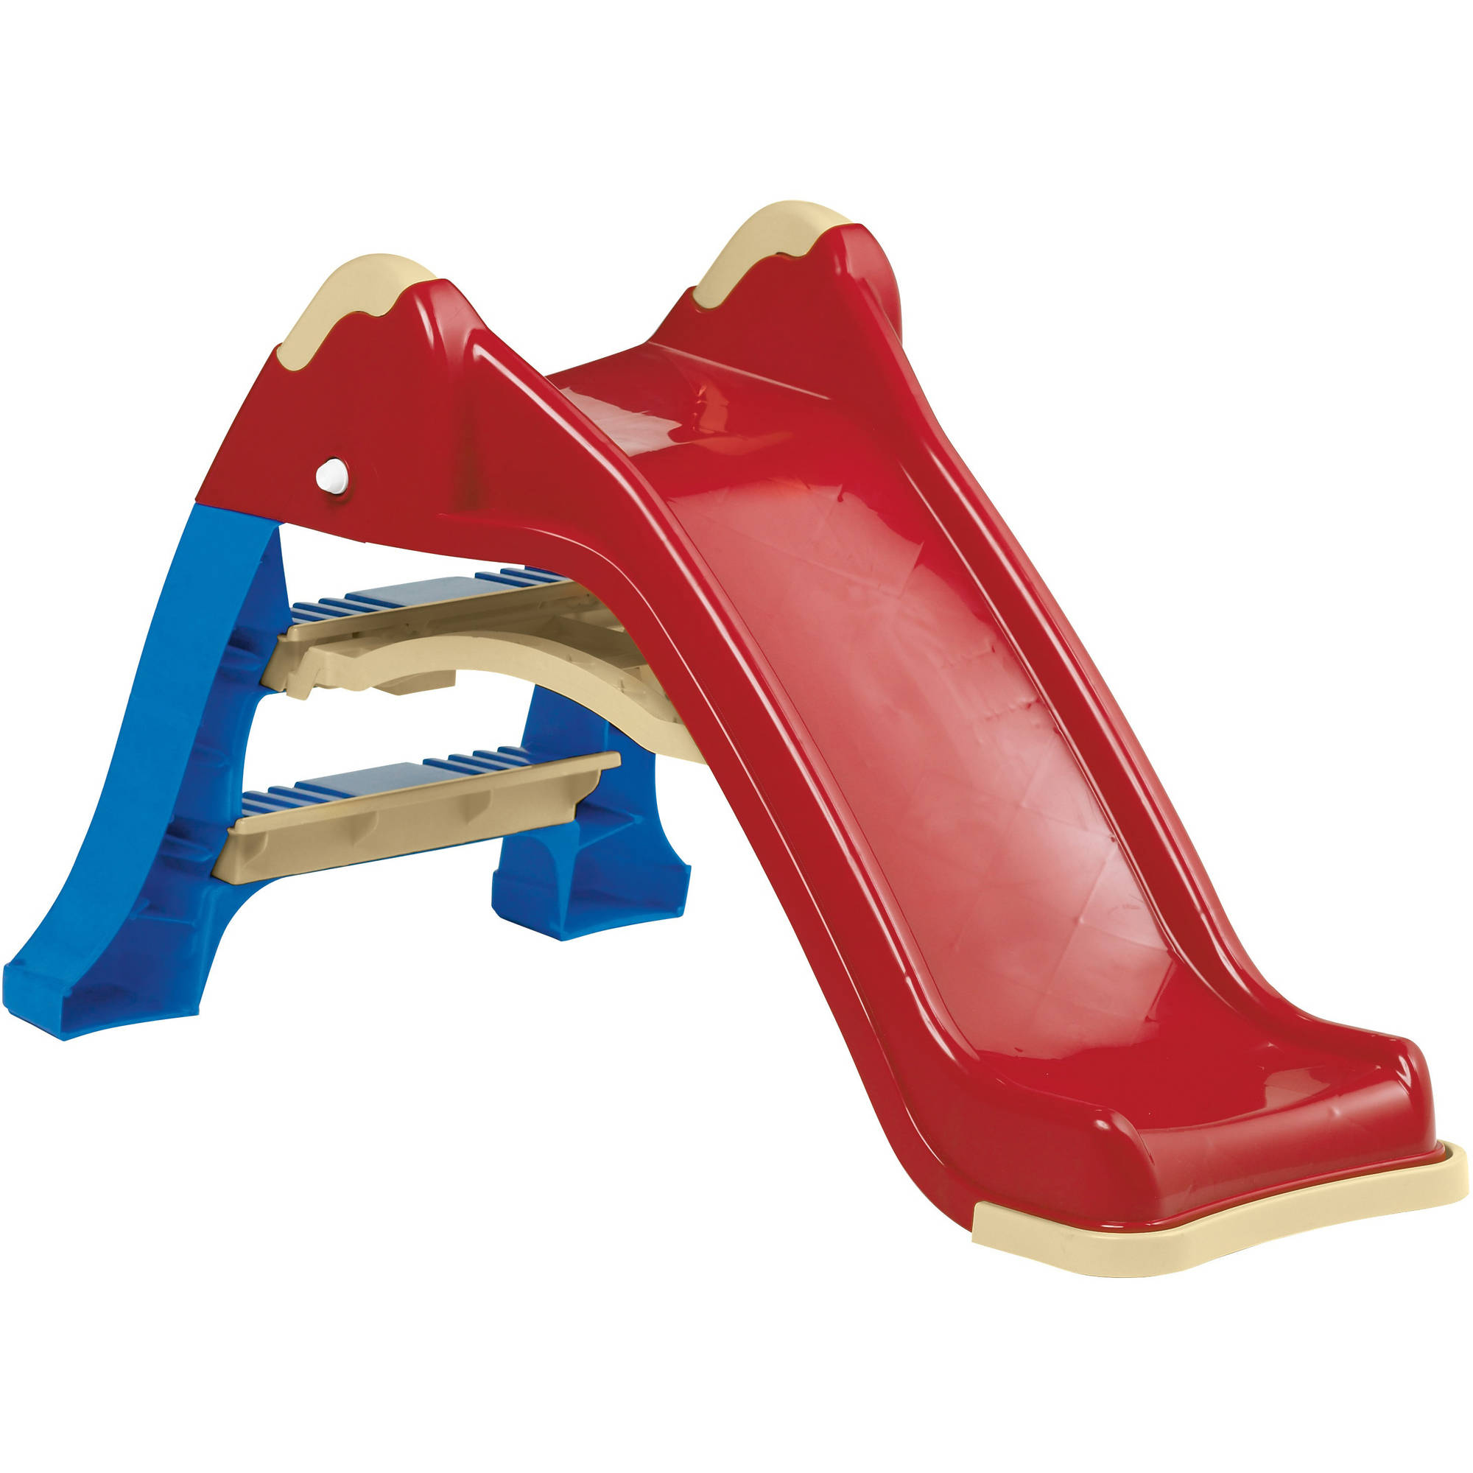
See this? Many kids want it.
Notes:
Click when saying see this—it will wiggle

Slide 10
Notes:
Question: See this mupa (click)? Can you find another mupa? Is it this one on top (click) or this one on bottom (click)?

Slide 11
Thanks for helping Maggie! Let’s help her learn some more puppet language.

Slide 12
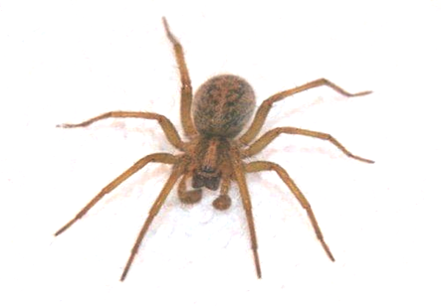
See this? This is a wubble. Wubbles get wet when it rains.
Notes:
Click when saying see this—it will wiggle

Slide 13
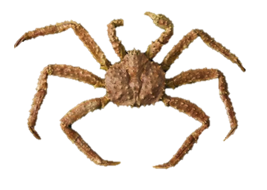
See this? It stays dry on a sunny day.
Notes:
Click when saying see this—it will wiggle

Slide 14
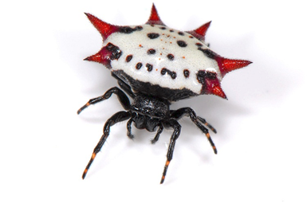
See this? It gets wet when it rains.
Notes:
Click when saying see this—it will wiggle

Slide 15
Notes:
Question: See this wubble (click)? Can you find another wubble? Is it this one on top (click) or this one on bottom (click)?

Slide 16

See this? This is a hudi. Hudis sometimes move back and forth during a storm.

Slide 17
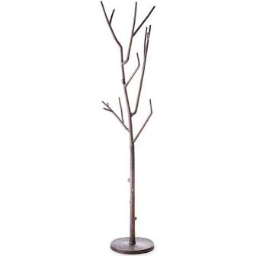
See this? Many people like it.

Slide 18
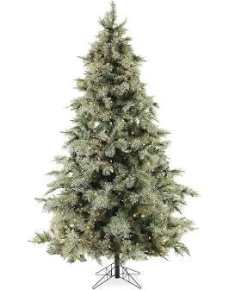
See this? It moves back and forth during a storm.

Slide 19
Notes:
Question: See this hudi (click)? Can you find another hudi? Is it this one on top (click) or this one on bottom (click)?

Slide 20
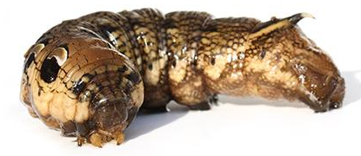
See this? This is a miko. Mikos are wide.
Notes:
Question: See this miko (click)? Can you find another miko? Is it this one on top (click) or this one on bottom (click)?

Slide 21
See this? It is long.
Notes:
Question: See this miko (click)? Can you find another miko? Is it this one on top (click) or this one on bottom (click)?

Slide 22
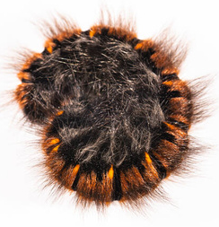
See this? It is wide.
Notes:
Question: See this miko (click)? Can you find another miko? Is it this one on top (click) or this one on bottom (click)?

Slide 23
Notes:
Question: See this miko (click)? Can you find another miko? Is it this one on top (click) or this one on bottom (click)?

Slide 24
Notes:
Question: See this miko (click)? Can you find another miko? Is it this one on top (click) or this one on bottom (click)?

Slide 25
Notes:
Question: See this miko (click)? Can you find another miko? Is it this one on top (click) or this one on bottom (click)?

Slide 26
Notes:
Question: See this miko (click)? Can you find another miko? Is it this one on top (click) or this one on bottom (click)?

Slide 27
Thanks for helping Maggie! Let’s help her learn some more puppet language.
Notes:
Thanks so much for helping Maggie. We are halfway through the game. Lets keep going!

Slide 28

See this? This is a vemo. Vemos are sometimes very far away.
Notes:
Question: See this vemo (click)? Can you find another vemo? Is it this one on top (click) or this one on bottom (click)?

Slide 29

See this? It sometimes very close.
Notes:
Question: See this vemo (click)? Can you find another vemo? Is it this one on top (click) or this one on bottom (click)?

Slide 30
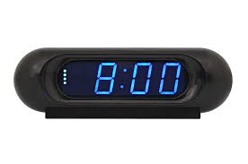
See this? It is sometimes very far away.
Notes:
Question: See this vemo (click)? Can you find another vemo? Is it this one on top (click) or this one on bottom (click)?

Slide 31
Notes:
Question: See this vemo (click)? Can you find another vemo? Is it this one on top (click) or this one on bottom (click)?

Slide 32
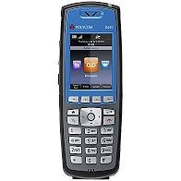
See this? This is a gerp. Gerps are hard to see at night.
Notes:
Click when saying see this—it will wiggle

Slide 33

See this? It sometimes looks far away.
Notes:
Click when saying see this—it will wiggle

Slide 34
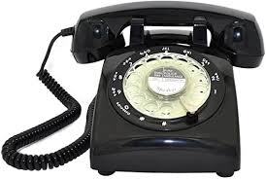
See this? It is hard to see at night.
Notes:
Click when saying see this—it will wiggle

Slide 35
Notes:
Question: See this gerp (click)? Can you find another gerp? Is it this one on top (click) or this one on bottom (click)?

Slide 36
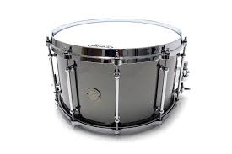
See this? This is a feld. Felds are heavy.
Notes:
Question: See this feld (click)? Can you find another feld? Is it this one on top (click) or this one on bottom (click)?

Slide 37
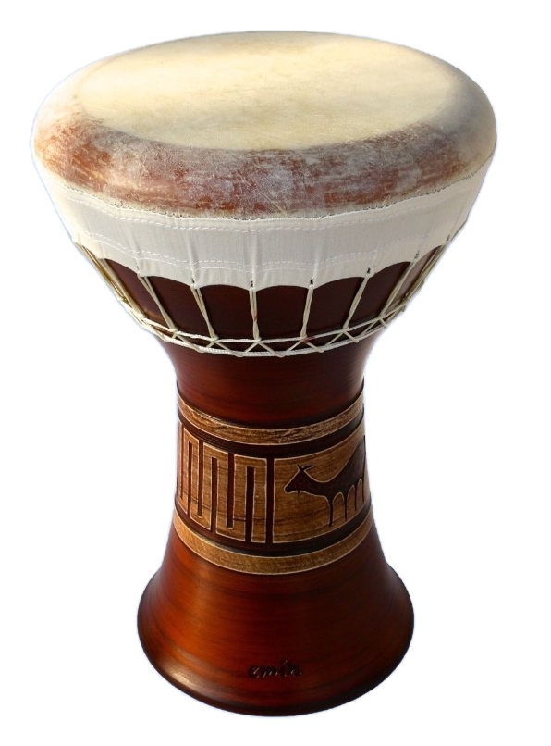
See this? It is heavy.
Notes:
Question: See this feld (click)? Can you find another feld? Is it this one on top (click) or this one on bottom (click)?

Slide 38
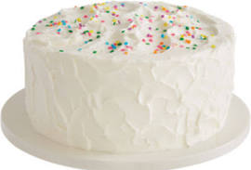
See this? It is wide.
Notes:
Question: See this feld (click)? Can you find another feld? Is it this one on top (click) or this one on bottom (click)?

Slide 39
Notes:
Question: See this feld (click)? Can you find another feld? Is it this one on top (click) or this one on bottom (click)?

